Slide 1
Student Survey
DS 103 Lesson 5 HandsOn

Slide 2
Is this data suitable for factor analysis?
Are there items that can be grouped together in the 12 areas?
Here are the 12 areas
Department provides comprehensive guidelines to the students in advance by means of a brochure/handbook
Department ensures a conducive learning environment
Academic decisions are taken with fairness and transparency
Academic calendar is maintained properly
Results are published timely in compliance with the ordinance
Students’ opinion regarding academic and extra-academic matters are addressed properly
Student feedback process is in practice
Website is informative and updated properly
Curriculum load is optimum and induces no pressure
Courses in the curriculum from lower level to higher are properly arranged
Teaching strategies are clearly stated in the curriculumsparency
Assessment strategies are clearly stated in the curriculum

Slide 3
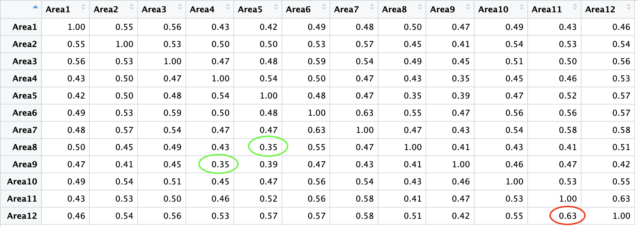
Testing the assumptions for EFA
Sample size: This data has 12 areas and 500 total entries. Even with NA responses removed, 464 entries remain.
Absence of Multicollinearity: The highest correlation is in red, 0.63. Lowest is 0.35
Also, the determinant is 0.002180, which is greater than .0001

Slide 4
Testing the assumptions for EFA, continued
3. Some relationship between Survey items.
Again, the lowest correlation on the matrix is 0.35, but also the Bartlett’s test revealed a p.value of 0, which is significant.

Slide 5
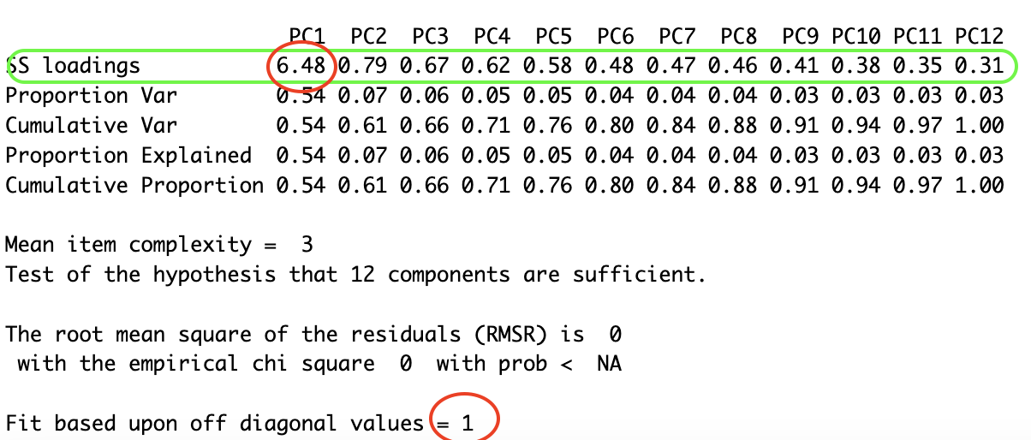
Basic Principal Components Analysis
Next, we ran the principal analysis using 12 factors (for each area) with no rotation.
The SS loadings contain the eigenvalues, and the only one greater than 1 was in the first column, with a value of 6.48. Also the “fit based upon off diagonal values” at the bottom also indicates it’s only 1.

Slide 6
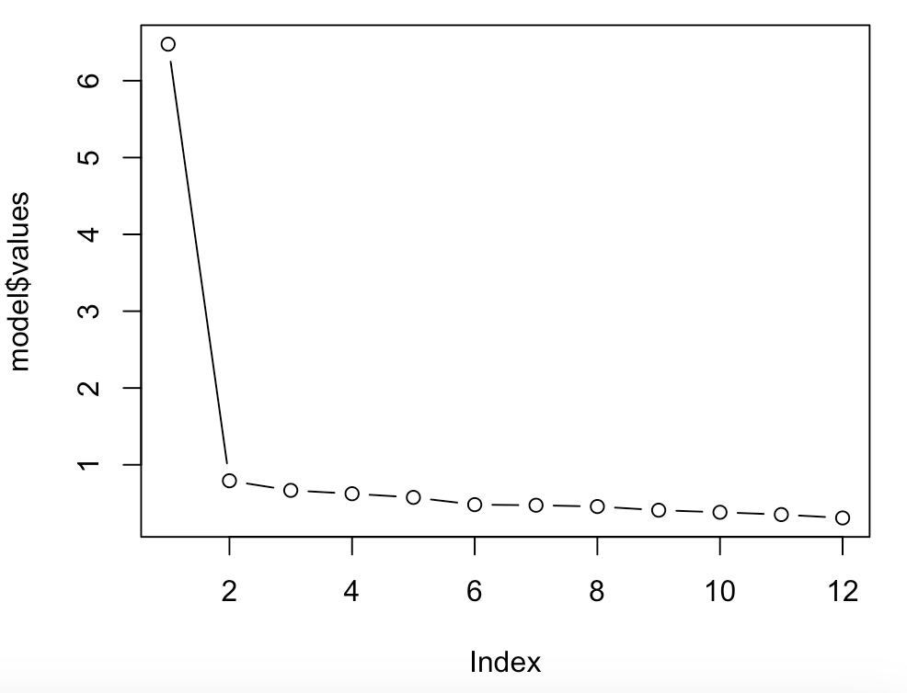
Examination of the Scree Plot
This does seem to have a big break from the beginning. This indicates there is indeed only 1 factor.

Slide 7
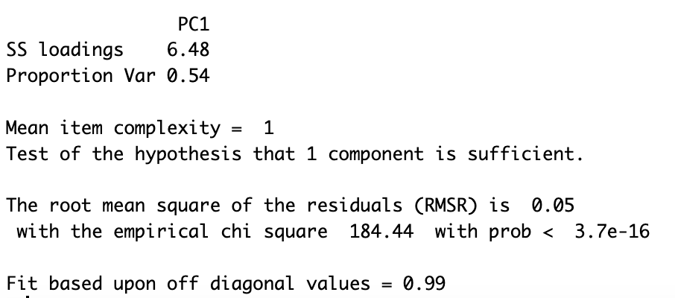
Second Pass to Test the Suspected Number of Factors
Ran a second test and sure enough, the eigenvalue remained 6.48…

Slide 8
Examining Residuals to determine Model Fit
The residuals revealed that 45%, or less than 50% of the residuals were large, so having only one factor is a pretty good model.
** Only one factor is indicated***

Slide 9
Is the scale considered reliable through inter-rater reliability?
Chronbach’s alpha (raw-alpha) was 0.92 >0.8, so the scale has pretty good reliability.

Slide 10
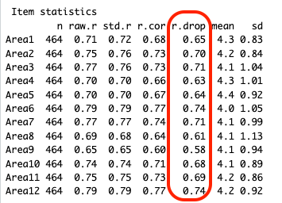
Is the scale considered reliable through inter-item reliability?
The r.drop column shows the corrected item-total correlation or the item-rest correlation. All of the values are above .3, so it is.

